Slide 1
SVX Data Flow
Steve Hoover
Aug 2013

Slide 2
Agenda
Transaction-Level Modeling in SVX
The meaning of X
Examples
Toy Ring
AES (encryption logic)
Latch-based AES (Synchronous ELastic Flow – SELF)
Takeaway

Slide 3
Transactions and Data Flow in SVX
Logic is expressed in the context of transactions which traverse pipelines and flows
SVXpp manages the staging/progression of signals through the pipelines/flows as required based on producing/consuming stages. SVXpp generates all flops/latches
Transaction flow can be expressed independently from the logic of the transaction
Transaction flow can be defined in libraries that are independent of the transaction logic that occurs within the flow. Note that generic library capabilities are purely proof-of-concept at this point and are not recommended for broad deployment.
Flow elements include FIFOs, queues, arbiters, back-pressure, bypass, etc.
The transaction logic is bucketed to pipelines and pipestages defined by the flow; logic can be re-bucketed w/ no impact to behavior

Slide 4
Flow Example
FIFO
QUEUE
free-flow
pipeline
backpress.
pipeline
free-flow
pipeline
free-flow
pipeline
Bypass
Transaction Logic
comb
comb
comb
comb
comb
comb
comb
comb
0
bypass

Slide 5
Mapping Logic to Pipeline/Pipestage
FIFO
QUEUE
free-flow
pipeline
backpress.
pipeline
free-flow
pipeline
free-flow
pipeline
Bypass
comb
comb
comb
comb
comb
comb
comb
comb
0
bypass

Slide 6
Design Changes
FIFO
QUEUE
free-flow
pipeline
backpress.
pipeline
free-flow
pipeline
free-flow
pipeline
Bypass
comb
comb
comb
comb
comb
comb
comb
comb
0
bypass

Slide 7
Design Changes
FIFO
QUEUE
free-flow
pipeline
backpress.
pipeline
free-flow
pipeline
free-flow
pipeline
Bypass
comb
comb
comb
comb
comb
comb
comb
comb
Old FIFO contents
0
bypass
New FIFO contents

Slide 8
Proof of Concept for Library Development in SVX
M4 macro-preprocessor in front of SVX
Provides easy solution for parameterization, replication, etc.
Not a long-term solution; very messy syntax
Provides proof-on-concept prior to native SVX language features
Created back-pressured pipeline
Each stage of the pipeline is a unique SVX (non-backpressured) pipeline
Signals pulled from one stage/pipeline to the next through a gated flop or recirculating mux as needed by the transaction logic.
This is done with wildcarded signals ($ANY) as inputs/outputs of SV expressions. Eg:
which says, recirculate the transaction from the previous cycle, or accept the transaction from the previous stage. (Granted, I haven’t explained the syntax.)
These expressions construct a data flow graph which could be searched to find and pull transaction fields (signals) through the flow.

Slide 9
Performance Modeling in SVX
SVX data flow makes it feasible to create concise abstract models
Models are synthesizable, enabling emulation of abstract models
Other SVX capabilities, not discussed in this presentation, assist in bridging the gap between abstract and RTL details
This enables a radical methodology change where performance models and models for architectural exploration could exist as part of the same code pool that provides RTL
Perf/arch models evolve into RTL
Validation is enabled earlier
Perf models and RTL are better aligned
Mix and match of “RTL” and perf components makes it easier to isolate the performance contributions of different “RTL” components

Slide 10
Agenda
Transaction-Level Modeling in SVX
The meaning of X
Examples
Toy Ring
AES (encryption logic)
Latch-based AES (Synchronous ELastic Flow – SELF)
Takeaway

Slide 11
Don’t-Care Injection w/ SVX
Xs have two meanings:
Don’t-Know: We don’t know what value the signal has. Could be 0 or 1.
Don’t-Care: It doesn’t matter what value the signal has. Not visible impact either way.
If we Don’t-Know, we must ensure that we Don’t-Care – that’s what determinism validation is all about.
SVX makes it easy to provide Don’t-Care information as a reflection of design intent. Eg: fields of an invalid transaction.
SVXpp can generate SV code capable of injecting Don’t-Cares.
Catch violations of design intent that would otherwise go undetected because they don’t manifest as real functional bugs.
Filter out noise for debug (next 2 slides).

Slide 12
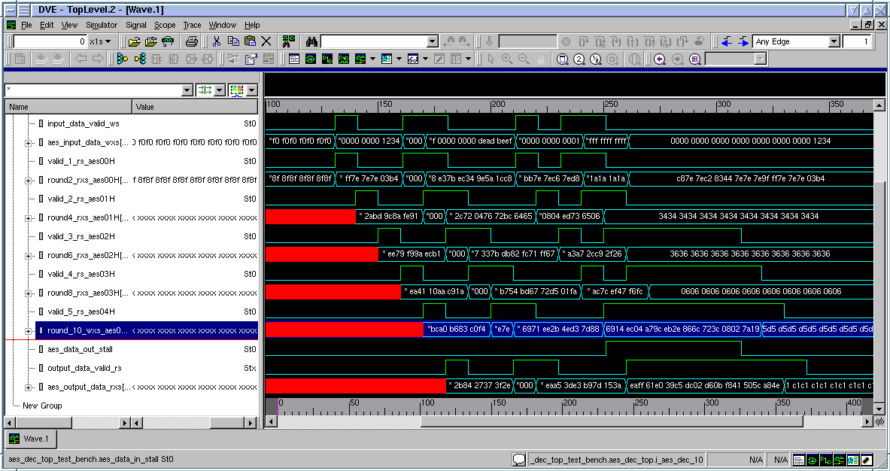
SV Trace Example (AES)

Slide 13
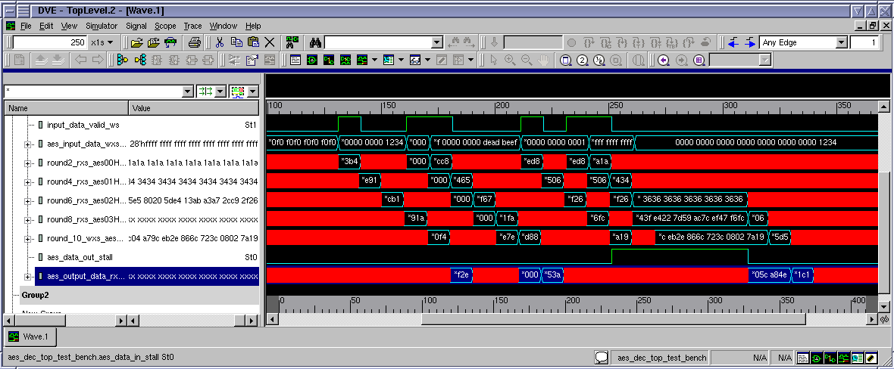
SVX Trace Example (AES)

Slide 14
Determinism Validation
Determinism validation ensures that Don’t-Know initial states are eliminated by cold reset (and are therefore Don’t-Cares).
With no distinction in simulation between Don’t-Know and Don’t-Care, X-injection for Don’t-Cares would get in the way of determinism validation, so it is disabled.
In other 4-state simulations, Xs are Don’t-Cares and X-injection is enabled. X-propagation ensures that Don’t-Cares really do not get consumed.

Slide 15
Agenda
Transaction-Level Modeling in SVX
The meaning of X
Examples
Toy Ring
AES (encryption logic)
Latch-based AES (Synchronous ELastic Flow – SELF)
Takeaway

Slide 16
Ring Example
data
data
valid
valid
backpressure
backpressure
valid
valid
dest
dest
valid
dest
data
data
valid
dest
data
data
data
data
valid
valid
backpressure
backpressure
valid
valid
dest
dest
valid
dest
data
data
valid
dest
data
data
data
data
valid
valid
backpressure
backpressure
valid
valid
dest
dest
valid
dest
data
data
valid
dest
data
data
data
data
valid
valid
backpressure
backpressure
valid
valid
dest
dest
valid
dest
data
data
valid
dest
data
data

Slide 17
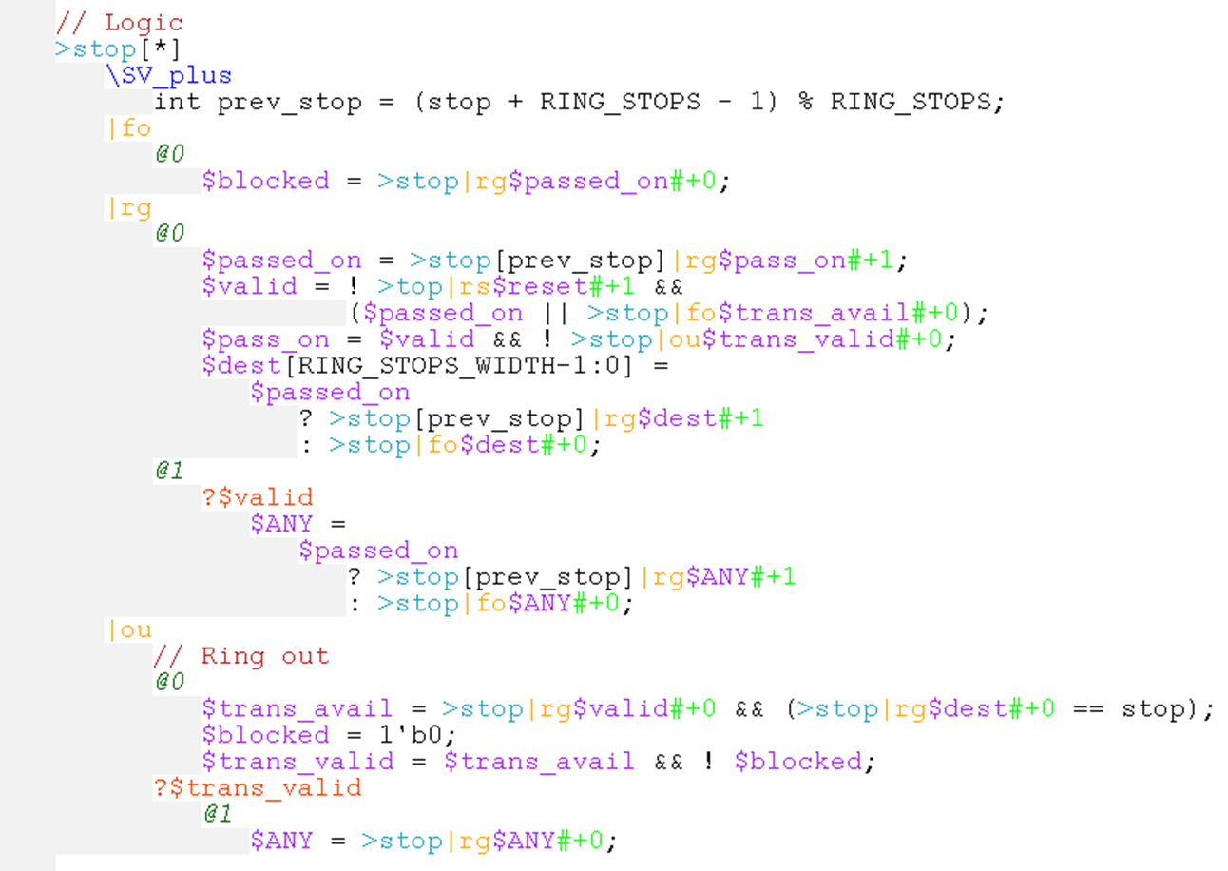
Ring code (expanded from invocation)
|ou
>stop[*]:
|rg
|fo
data
valid
backpressure
valid
dest
valid
dest
data
data
@0
@1
@2

Slide 18
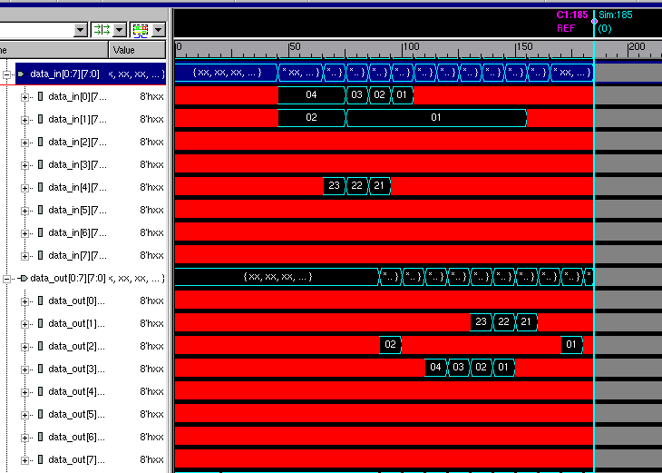
Simulation

Slide 19
Ring + FIFOs
(fllop-based, w/ bypass
and single encoded
head/tail pointer mask)
data
data
valid
valid
backpressure
backpressure
valid
valid
dest
dest
valid
dest
data
data
valid
dest
data
data
data
data
valid
valid
backpressure
backpressure
valid
valid
dest
dest
valid
dest
data
data
valid
dest
data
data
data
data
valid
valid
backpressure
backpressure
valid
valid
dest
dest
valid
dest
data
data
valid
dest
data
data
data
data
valid
valid
backpressure
backpressure
valid
valid
dest
dest
valid
dest
data
data
valid
dest
data
data

Slide 20
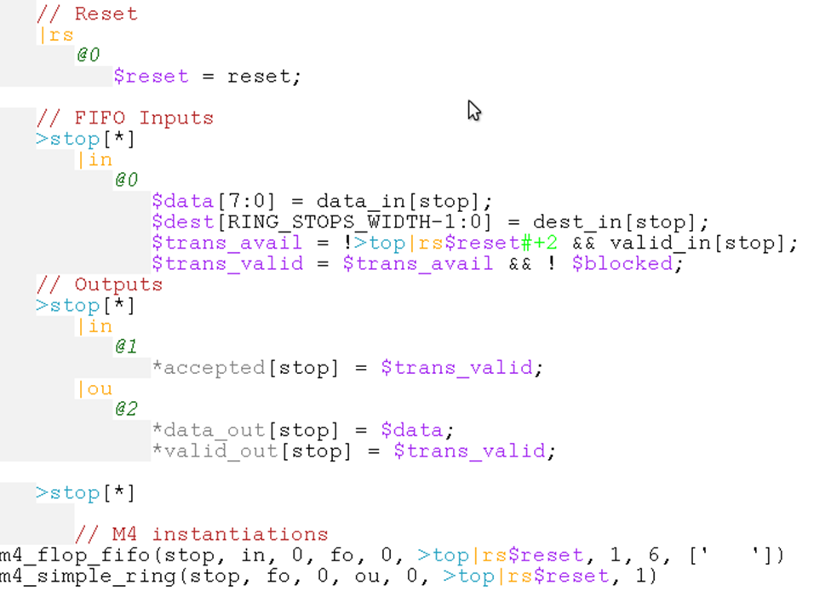
Ring + FIFOs SVX Code w/ SV Hookup
SV I/O hookup
Ring/FIFO instantiation

Slide 21
Scenario
Silent data corruption too high, determined late in the project
Decide to cover complete data path through FIFOs and ring with single parity bit. Generate parity prior to FIFO, check at ring egress.
Extra cycle required for parity generation.

Slide 22
Ring + FIFOs SVX Code w/ SV Hookup
Code change:
add $parity = …;
add $error = … $parity …;
0 → 1 (to feed FIFO 1 cycle later)
@1 (to consume backpressure 1 cycle later) (caught by SVXpp)
~1 minute to modify & debug (addition of parity signal, not parity logic)
vs. ~100 lines of RTL change in generated RTL – bugs, bugs, bugs if done by hand!!!

Slide 23
Agenda
Transaction-Level Modeling in SVX
The meaning of X
Examples
Toy Ring
AES (encryption logic)
Latch-based AES (Synchronous ELastic Flow – SELF)
Takeaway

Slide 24
AES (logical)
bypass
swizzle
decode
decode
decode
decode
decode
decode
decode
decode
decode
decode
convert
data
data
en
data
data
en
data
data
en
data
data
en
data
data
valid.
valid.
valid.
valid.
valid.
en
valid.
en
backpress.
backpress.
backpress.
backpress.
backpress.
backpress.

Slide 25
AES (implementation)
swizzle
decode
decode
decode
decode
decode
decode
decode
decode
decode
decode
convert
data
data
en
data
data
en
data
data
en
data
data
en
data
data
valid.
valid.
valid.
valid.
valid.
en
valid.
en
backpress.
backpress.
backpress.
backpress.
backpress.
backpress.

Slide 26
Top-Level AES Code (Boxes from block diag. are SV instantiations)
`include "soc_clocks.sv"
module aes_dec_10
(
aes_clk
, reset_b
, bypass
, bypass_data_in_wxs
, aes_input_data_wxs
, input_data_valid_ws
, key_initial_wxs
, key_round10_wxs
, key_round1_wxs
, key_round2_wxs
, key_round3_wxs
, key_round4_wxs
, key_round5_wxs
, key_round6_wxs
, key_round7_wxs
, key_round8_wxs
, key_round9_wxs
, aes_output_data_rxs
, output_data_valid_rs
, aes_data_in_stall
, aes_data_out_stall
);
input aes_clk ;
input reset_b ; // Low asserted Reset
input input_data_valid_ws ;
input bypass ;
input [127:0] bypass_data_in_wxs ;
input [127:0] aes_input_data_wxs ;
input [127:0] key_initial_wxs ;
input [127:0] key_round10_wxs ;
input [127:0] key_round1_wxs ;
input [127:0] key_round2_wxs ;
input [127:0] key_round3_wxs ;
input [127:0] key_round4_wxs ;
input [127:0] key_round5_wxs ;
input [127:0] key_round6_wxs ;
input [127:0] key_round7_wxs ;
input [127:0] key_round8_wxs ;
input [127:0] key_round9_wxs ;
input aes_data_out_stall ;
output aes_data_in_stall ;
output [127:0] aes_output_data_rxs ;
output output_data_valid_rs ;
wire aes_clk ;
wire reset_b ;
reg bypass_1_rs ;
reg bypass_2_rs ;
reg bypass_3_rs ;
reg bypass_4_rs ;
reg bypass_5_rs ;
reg valid_1_rs ;
reg valid_2_rs ;
reg valid_3_rs ;
reg valid_4_rs ;
reg valid_5_rs ;
wire output_data_valid_rs ;
wire input_data_valid_ws ;
wire bypass ;
wire [127:0] bypass_data_in_wxs ;
reg [127:0] aes_output_data_gf4_rxs ;
wire [127:0] aes_output_data_gf8_rxs ;
wire [127:0] aes_input_data_wxs ;
wire [127:0] aes_input_data_wxs_byte_reverse ;
wire [127:0] aes_output_data_rxs ;
wire [127:0] key_initial_wxs ;
wire [127:0] key_round1_wxs ;
wire [127:0] key_round2_wxs ;
wire [127:0] key_round3_wxs ;
wire [127:0] key_round4_wxs ;
wire [127:0] key_round5_wxs ;
wire [127:0] key_round6_wxs ;
wire [127:0] key_round7_wxs ;
wire [127:0] key_round8_wxs ;
wire [127:0] key_round9_wxs ;
wire [127:0] key_round10_wxs ;
reg [127:0] round_2_rxs ;
reg [127:0] round_4_rxs ;
reg [127:0] round_6_rxs ;
reg [127:0] round_8_rxs ;
logic [127:0] round_2_trans_rxs ;
logic [127:0] round_4_trans_rxs ;
logic [127:0] round_6_trans_rxs ;
logic [127:0] round_8_trans_rxs ;
wire [127:0] round_1_wxs ;
wire [127:0] round_2_wxs ;
wire [127:0] round_3_wxs ;
wire [127:0] round_4_wxs ;
wire [127:0] round_5_wxs ;
wire [127:0] round_6_wxs ;
wire [127:0] round_7_wxs ;
wire [127:0] round_8_wxs ;
wire [127:0] round_9_wxs ;
wire [127:0] round_10_wxs ;
wire [127:0] round_2_or_byp_wxs ;
wire [127:0] round_4_or_byp_wxs ;
wire [127:0] round_6_or_byp_wxs ;
wire [127:0] round_8_or_byp_wxs ;
wire [127:0] round_10_or_byp_wxs ;
wire space_avail_5 ;
wire space_avail_4 ;
wire space_avail_3 ;
wire space_avail_2 ;
wire space_avail_1 ;
wire enable_0 ;
wire enable_1 ;
wire enable_2 ;
wire enable_3 ;
wire enable_4 ;
wire clkand1 ;
wire clkand2 ;
wire clkand3 ;
wire clkand4 ;
aes_byte_reverse aes_byte_reverse_data_out //fix endianess
(
.data_in (aes_input_data_wxs),
.data_out (aes_input_data_wxs_byte_reverse)
);
assign space_avail_5 = ~valid_5_rs | ~aes_data_out_stall;
assign space_avail_4 = ~valid_4_rs | space_avail_5;
assign space_avail_3 = ~valid_3_rs | space_avail_4;
assign space_avail_2 = ~valid_2_rs | space_avail_3;
assign space_avail_1 = ~valid_1_rs | space_avail_2;
assign enable_0 = input_data_valid_ws & space_avail_1;
assign enable_1 = valid_1_rs & space_avail_2;
assign enable_2 = valid_2_rs & space_avail_3;
assign enable_3 = valid_3_rs & space_avail_4;
assign enable_4 = valid_4_rs & space_avail_5;
assign aes_data_in_stall = ~space_avail_1 ;
always_ff @ ( posedge aes_clk ) begin
if (~reset_b) begin
valid_1_rs <= '0;
bypass_1_rs <= '0;
end
else if (~aes_data_out_stall | space_avail_1) begin
valid_1_rs <= ( input_data_valid_ws );
bypass_1_rs <= ( bypass );
end
else if (~(~aes_data_out_stall | space_avail_1)) begin
valid_1_rs <= valid_1_rs ;
bypass_1_rs <= bypass_1_rs ;
end
else begin
valid_1_rs <= 'X;
bypass_1_rs <= 'X;
end
end
always_ff @ ( posedge aes_clk ) begin
if (~reset_b) begin
valid_2_rs <= '0;
bypass_2_rs <= '0;
end
else if (~aes_data_out_stall | space_avail_2) begin
valid_2_rs <= ( valid_1_rs );
bypass_2_rs <= ( bypass_1_rs );
end
else if (~(~aes_data_out_stall | space_avail_2)) begin
valid_2_rs <= valid_2_rs ;
bypass_2_rs <= bypass_2_rs ;
end
else begin
valid_2_rs <= 'X;
bypass_2_rs <= 'X;
end
end
always_ff @ ( posedge aes_clk ) begin
if (~reset_b) begin
valid_3_rs <= '0;
bypass_3_rs <= '0;
end
else if (~aes_data_out_stall | space_avail_3) begin
valid_3_rs <= ( valid_2_rs );
bypass_3_rs <= ( bypass_2_rs );
end
else if (~(~aes_data_out_stall | space_avail_3)) begin
valid_3_rs <= valid_3_rs ;
bypass_3_rs <= bypass_3_rs ;
end
else begin
valid_3_rs <= 'X;
bypass_3_rs <= 'X;
end
end
always_ff @ ( posedge aes_clk ) begin
if (~reset_b) begin
valid_4_rs <= '0;
bypass_4_rs <= '0;
end
else if (~aes_data_out_stall | space_avail_4) begin
valid_4_rs <= ( valid_3_rs );
bypass_4_rs <= ( bypass_3_rs );
end
else if (~(~aes_data_out_stall | space_avail_4)) begin
valid_4_rs <= valid_4_rs ;
bypass_4_rs <= bypass_4_rs ;
end
else begin
valid_4_rs <= 'X;
bypass_4_rs <= 'X;
end
end
always_ff @ ( posedge aes_clk ) begin
if (~reset_b) begin
valid_5_rs <= '0;
bypass_5_rs <= '0;
end
else if (~aes_data_out_stall | space_avail_5) begin
valid_5_rs <= ( valid_4_rs );
bypass_5_rs <= ( bypass_4_rs );
end
else if (~(~aes_data_out_stall | space_avail_5)) begin
valid_5_rs <= valid_5_rs ;
bypass_5_rs <= bypass_5_rs ;
end
else begin
valid_5_rs <= 'X;
bypass_5_rs <= 'X;
end
end
assign output_data_valid_rs = valid_5_rs;
assign round_2_or_byp_wxs = bypass ? bypass_data_in_wxs : round_2_wxs ;
assign round_4_or_byp_wxs = bypass_1_rs ? round_2_rxs : round_4_wxs ;
assign round_6_or_byp_wxs = bypass_2_rs ? round_4_rxs : round_6_wxs ;
assign round_8_or_byp_wxs = bypass_3_rs ? round_6_rxs : round_8_wxs ;
assign round_10_or_byp_wxs = bypass_4_rs ? round_8_rxs : round_10_wxs ;
always_ff @ ( posedge aes_clk ) begin
if ( enable_0 )
round_2_rxs[127:0] <= ( round_2_or_byp_wxs[127:0] );
else if ( !enable_0 )
round_2_rxs[127:0] <= round_2_rxs[127:0] ;
else
round_2_rxs[127:0] <= 'X;
end
generate
always_comb
round_2_trans_rxs = round_2_rxs;
endgenerate
always_ff @ ( posedge aes_clk ) begin
if ( enable_1 )
round_4_rxs[127:0] <= ( round_4_or_byp_wxs[127:0] );
else if ( !enable_1 )
round_4_rxs[127:0] <= round_4_rxs[127:0] ;
else
round_4_rxs[127:0] <= 'X;
end
generate
always_comb
round_4_trans_rxs = round_4_rxs
endgenerate
always_ff @ ( posedge aes_clk ) begin
if ( enable_2 )
round_6_rxs[127:0] <= ( round_6_or_byp_wxs[127:0] );
else if ( !enable_2 )
round_6_rxs[127:0] <= round_6_rxs[127:0] ;
else
round_6_rxs[127:0] <= 'X;
end
generate
always_comb
round_6_trans_rxs = round_6_rxs;
endgenerate
always_ff @ ( posedge aes_clk ) begin
if ( enable_3 )
round_8_rxs[127:0] <= ( round_8_or_byp_wxs[127:0] );
else if ( !enable_3 )
round_8_rxs[127:0] <= round_8_rxs[127:0] ;
else
round_8_rxs[127:0] <= 'X;
end
generate
always_comb
round_8_trans_rxs = round_8_rxs;
endgenerate
always_ff @ ( posedge aes_clk ) begin
if ( enable_4 )
aes_output_data_gf4_rxs[127:0] <= ( round_10_or_byp_wxs[127:0] );
else if ( !enable_4 )
aes_output_data_gf4_rxs[127:0] <= aes_output_data_gf4_rxs[127:0] ;
else
aes_output_data_gf4_rxs[127:0] <= 'X;
end
// Instantiate 10 rounds of decrypt logic
//
aes_dec2_firstround i_aes_dec_1 (
.first_key_in_wxs ( key_initial_wxs[127:0] )
, .round_data_in_wxs ( aes_input_data_wxs_byte_reverse[127:0] )
, .round_key_in_wxs ( key_round1_wxs[127:0] )
, .round_data_out_wxs ( round_1_wxs[127:0] )
);
aes_dec2 i_aes_dec_2 (
.round_data_in_wxs ( round_1_wxs[127:0] )
, .round_key_in_wxs ( key_round2_wxs[127:0] )
, .round_data_out_wxs ( round_2_wxs[127:0] )
);
aes_dec2 i_aes_dec_3 (
.round_data_in_wxs ( round_2_trans_rxs[127:0] )
, .round_key_in_wxs ( key_round3_wxs[127:0] )
, .round_data_out_wxs ( round_3_wxs[127:0] )
);
aes_dec2 i_aes_dec_4 (
.round_data_in_wxs ( round_3_wxs[127:0] )
, .round_key_in_wxs ( key_round4_wxs[127:0] )
, .round_data_out_wxs ( round_4_wxs[127:0] )
);
aes_dec2 i_aes_dec_5 (
.round_data_in_wxs ( round_4_trans_rxs[127:0] )
, .round_key_in_wxs ( key_round5_wxs[127:0] )
, .round_data_out_wxs ( round_5_wxs[127:0] )
);
aes_dec2 i_aes_dec_6 (
.round_data_in_wxs ( round_5_wxs[127:0] )
, .round_key_in_wxs ( key_round6_wxs[127:0] )
, .round_data_out_wxs ( round_6_wxs[127:0] )
);
aes_dec2 i_aes_dec_7 (
.round_data_in_wxs ( round_6_trans_rxs[127:0] )
, .round_key_in_wxs ( key_round7_wxs[127:0] )
, .round_data_out_wxs ( round_7_wxs[127:0] )
);
aes_dec2 i_aes_dec_8 (
.round_data_in_wxs ( round_7_wxs[127:0] )
, .round_key_in_wxs ( key_round8_wxs[127:0] )
, .round_data_out_wxs ( round_8_wxs[127:0] )
);
aes_dec2 i_aes_dec_9 (
.round_data_in_wxs ( round_8_trans_rxs[127:0] )
, .round_key_in_wxs ( key_round9_wxs[127:0] )
, .round_data_out_wxs ( round_9_wxs[127:0] )
);
aes_dec2 i_aes_dec_10 (
.round_data_in_wxs ( round_9_wxs[127:0] )
, .round_key_in_wxs ( key_round10_wxs[127:0] )
, .round_data_out_wxs ( round_10_wxs[127:0] )
);
// Convert final result back to GF(2^8)
//
aes_gf4_inv_transform128 i_inv_xform128 (
.inv_transform_in_wxs ( aes_output_data_gf4_rxs[127:0] )
, .transform_out_wxs ( aes_output_data_gf8_rxs[127:0] )
);
assign aes_output_data_rxs = bypass_5_rs ? aes_output_data_gf4_rxs : aes_output_data_gf8_rxs ;
endmodule
\SVX_version 0.1: https://mmdc-wiki.hd.intel.com/wiki/bin/edit.cgi/MMDCArch/SvxMain
\SV
`include "soc_clocks.sv"
m4_include(['m4/pipeflow_lib.vxm4'])
module aes_dec_10
# (
parameter USE_TRANSPARENT_LATCHES = 0
)
(
aes_clk
, reset_b
, bypass
, bypass_data_in_wxs
, aes_input_data_wxs
, input_data_valid_ws
, key_initial_wxs
, key_round10_wxs
, key_round1_wxs
, key_round2_wxs
, key_round3_wxs
, key_round4_wxs
, key_round5_wxs
, key_round6_wxs
, key_round7_wxs
, key_round8_wxs
, key_round9_wxs
, aes_output_data_rxs
, output_data_valid_rs
, aes_data_in_stall
, aes_data_out_stall
);
input aes_clk ;
input reset_b ; // Low asserted Reset
input input_data_valid_ws ;
input bypass ;
input [127:0] bypass_data_in_wxs ;
input [127:0] aes_input_data_wxs ;
input [127:0] key_initial_wxs ;
input [127:0] key_round10_wxs ;
input [127:0] key_round1_wxs ;
input [127:0] key_round2_wxs ;
input [127:0] key_round3_wxs ;
input [127:0] key_round4_wxs ;
input [127:0] key_round5_wxs ;
input [127:0] key_round6_wxs ;
input [127:0] key_round7_wxs ;
input [127:0] key_round8_wxs ;
input [127:0] key_round9_wxs ;
input aes_data_out_stall ;
output aes_data_in_stall ;
output [127:0] aes_output_data_rxs ;
output output_data_valid_rs ;
wire aes_clk ;
wire reset_b ;
wire output_data_valid_rs ;
wire input_data_valid_ws ;
wire bypass ;
wire [127:0] bypass_data_in_wxs ;
wire [127:0] aes_input_data_wxs ;
wire [127:0] aes_output_data_rxs ;
wire [127:0] key_initial_wxs ;
wire [127:0] key_round1_wxs ;
wire [127:0] key_round2_wxs ;
wire [127:0] key_round3_wxs ;
wire [127:0] key_round4_wxs ;
wire [127:0] key_round5_wxs ;
wire [127:0] key_round6_wxs ;
wire [127:0] key_round7_wxs ;
wire [127:0] key_round8_wxs ;
wire [127:0] key_round9_wxs ;
wire [127:0] key_round10_wxs ;
node Clk_clk_UH;
node Clk_clk_UL;
assign Clk_clk_UH = aes_clk;
assign Clk_clk_UL = ~aes_clk;
\SVX
// =======================
//
// m4_bp_pipeline(...)
//
// Input stage hookup
|A1
@1
! *aes_data_in_stall = $blocked;
! $trans_avail = *input_data_valid_ws && *reset_b;
// The backpressured pipeline.
m4_bp_pipeline(A, 1, 6)
// Output stage hookup
|A6
@1
! $blocked = *aes_data_out_stall;
! *output_data_valid_rs = $trans_avail;
// ====================
// The transaction
// Ten stages of computation are done two-stages per cycle in each of |A1@1 -> |A5@1.
//
// SV inputs hookup
|A1
@1
$trans_valid = $trans_avail && ! $blocked;
?trans_valid
! $data_in[127:0] = *aes_input_data_wxs;
! $bypass = *bypass;
// Transaction, distributed throughout the pipeflow.
|A1
// Instantiate 10 rounds of decrypt logic
//
@1
?trans_valid
aes_byte_reverse aes_byte_reverse_data_out //fix endianess
(
.data_in ($data_in),
.data_out ($=aes_data_in_byte_reverse[127:0])
);
aes_dec2_firstround i_aes_dec_1 (
! .first_key_in_wxs ( *key_initial_wxs[127:0] )
, .round_data_in_wxs ( $aes_data_in_byte_reverse[127:0] )
! , .round_key_in_wxs ( *key_round1_wxs[127:0] )
, .round_data_out_wxs ( $=round1[127:0] )
);
aes_dec2 i_aes_dec_2 (
.round_data_in_wxs ( $round1[127:0] )
! , .round_key_in_wxs ( *key_round2_wxs[127:0] )
, .round_data_out_wxs ( $=round2[127:0] )
);
! $round2_or_byp[127:0] = $bypass ? *bypass_data_in_wxs : $round2;
|A2
@1
?trans_valid
aes_dec2 i_aes_dec_3 (
.round_data_in_wxs ( $round2_or_byp[127:0] )
! , .round_key_in_wxs ( *key_round3_wxs[127:0] )
, .round_data_out_wxs ( $=round3[127:0] )
);
aes_dec2 i_aes_dec_4 (
.round_data_in_wxs ( $round3[127:0] )
! , .round_key_in_wxs ( *key_round4_wxs[127:0] )
, .round_data_out_wxs ( $=round4[127:0] )
);
! $round4_or_byp[127:0] = $bypass ? $round2_or_byp : $round4;
|A3
@1
?trans_valid
aes_dec2 i_aes_dec_5 (
.round_data_in_wxs ( $round4_or_byp[127:0] )
! , .round_key_in_wxs ( *key_round5_wxs[127:0] )
, .round_data_out_wxs ( $=round5[127:0] )
);
aes_dec2 i_aes_dec_6 (
.round_data_in_wxs ( $round5[127:0] )
! , .round_key_in_wxs ( *key_round6_wxs[127:0] )
, .round_data_out_wxs ( $=round6[127:0] )
);
! $round6_or_byp[127:0] = $bypass ? $round4_or_byp : $round6;
|A4
@1
?trans_valid
aes_dec2 i_aes_dec_7 (
.round_data_in_wxs ( $round6_or_byp[127:0] )
! , .round_key_in_wxs ( *key_round7_wxs[127:0] )
, .round_data_out_wxs ( $=round7[127:0] )
);
aes_dec2 i_aes_dec_8 (
.round_data_in_wxs ( $round7[127:0] )
! , .round_key_in_wxs ( *key_round8_wxs[127:0] )
, .round_data_out_wxs ( $=round8[127:0] )
);
! $round8_or_byp[127:0] = $bypass ? $round6_or_byp : $round8;
|A5
@1
?trans_valid
aes_dec2 i_aes_dec_9 (
.round_data_in_wxs ( $round8_or_byp[127:0] )
! , .round_key_in_wxs ( *key_round9_wxs[127:0] )
, .round_data_out_wxs ( $=round9[127:0] )
);
aes_dec2 i_aes_dec_10 (
.round_data_in_wxs ( $round9[127:0] )
! , .round_key_in_wxs ( *key_round10_wxs[127:0] )
, .round_data_out_wxs ( $=round10[127:0] )
);
! $round10_or_byp[127:0] = $bypass ? $round8_or_byp : $round10;
|A6
@1
?trans_valid
// Convert final result back to GF(2^8)
//
aes_gf4_inv_transform128 i_inv_xform128 (
.inv_transform_in_wxs ( $round10_or_byp[127:0] )
, .transform_out_wxs ( $=round10_gf8[127:0] )
);
// SV outputs hookup
|A6
@1
?trans_valid
$data_out[127:0] = $bypass ? $round10_or_byp : $round10_gf8;
! *aes_output_data_rxs = $data_out;
\SV
endmodule
SVX Goodness:
Backpressured pipeline via library instantiation (green code) in SVX, eliminates control bugs (not practical in SV)
X-information provided in SVX for debug and checking
Easier retiming in SVX. Done for each new project.
Bypass optimization is specific to cycle boundaries. Impedes retiming. Need refinements (not yet implemented) to abstract this away.
SV:
SVX:
(w SV instantiations)
Key:
Interface & Declarations
Control
Logic

Slide 27
Agenda
Transaction-Level Modeling in SVX
The meaning of X
Examples
Toy Ring
AES (encryption logic)
Latch-based AES (Synchronous ELastic Flow – SELF)
Takeaway

Slide 28
Synchronous ELastic Flow (SELF)
Design style explored by Michael Kishinevsky, et. al., in Intel’s Strategic CAD Lab
In SELF, transactions flow through pipelines that are backpressured at each latch, not at each flop, allowing each latch to hold a transaction, providing ~2x capacity
Abandoned several years ago, mainly because it was hard to migrate existing RTL to SELF
With SVX this would be the flick of a switch
Created a proof-of-concept SELF pipeline
(It’s actually the same code used to create the AES flop-based backpressured pipeline, using M4 to parameterize)

Slide 29
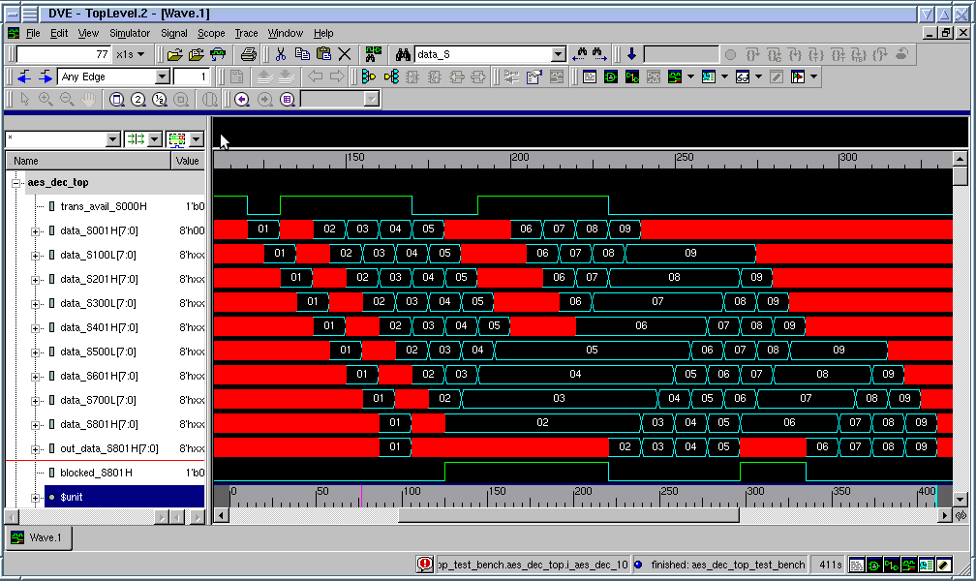
Data flowing through a SELF pipeline

Slide 30
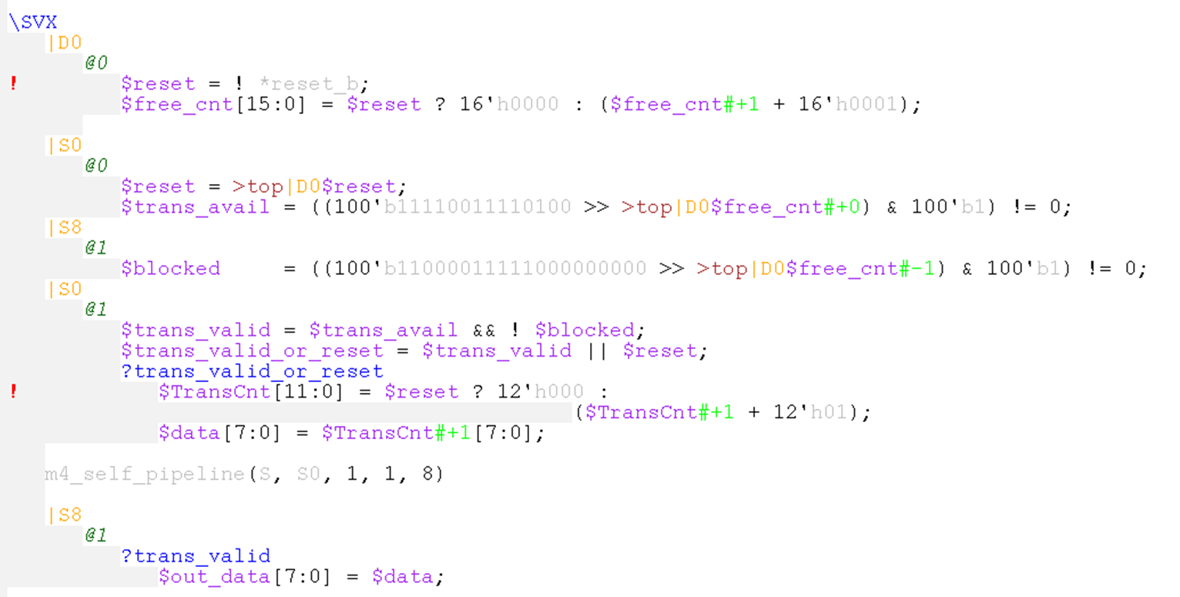
Code (w/o explanation)
This is the complete code and testbench generating the previous waveform (excluding generic library code and clock/reset inputs)
Testbench
Transaction In
Logic
Transaction
Out

Slide 31
AES Example and SELF
Conversion to SELF pipeline trivial in SVX (w/ M4 library)
Just change this instantiation:
m4_bp_pipeline(S, S0, 1, 1, 8)
To this:
m4_self_pipeline(S, S0, 1, 1, 8)
Transparency can be used to reduce latency (by moving A-phase instantiations to B-phase).
Provides 5 free cycles of backpressure storage, deemed beneficial by designer.
Note that SELF has implication to SCAN methodology w/ 2 states per “flop”.
Note that this example has not been synthesized, just simulated.

Slide 32
Agenda
Transaction-Level Modeling in SVX
The meaning of X
Examples
Toy Ring
AES (encryption logic)
Latch-based AES (Synchronous ELastic Flow – SELF)
Takeaway

Slide 33
Takeaway
Logic design does not have to be a painful experience ☺
Significant potential today, w/ small fraction of envisioned feature set.
Huge potential benefit w/ more investment.
We’re past the initial hump. An hour of investment will save more than an hour of project effort… on one project alone.
Need:
Investment
Industry/academic collaboration, open-sourcing
You!

